Slide 1
A Level Computer Science AQA 7516/1
C# Programming 2 – Selection

Slide 2
Key Vocabulary
Flowchart
IF…THEN…ELSE
Nesting
Switch/Case
Arithmetic operators, e.g. +, *, /, MOD
Relational operators, e.g. ==, !=
Boolean operators - AND, OR, NOT
Unreachable code
Mutually exclusive
Array
Overloading
Subroutine
Parameter

Slide 3
Programming Language Generations
First generation language – machine code
Patterns of binary digits
Codes corresponding to different operations (instruction set)
Machine specific
Second generation language – assembly code
Symbolic representation of operations (e.g. ADD #100)
Machine specific
Third generation – high level languages (e.g. Visual Basic)
Problem oriented – many different languages developed
Machine independent
Notes:
Assembly code – used when programs need to execute as efficiently as possible or when a high level language compiler is not available.
Device drivers and embedded system software are prime examples.

Slide 4
Compiling a Program
To run a program its code must be changed from source code into something your computer can understand.
Computers only understand 1’s and 0’s (binary numbers) object code (AKA machine code).
The Visual Basic compiler changes source code into object code.

Slide 5
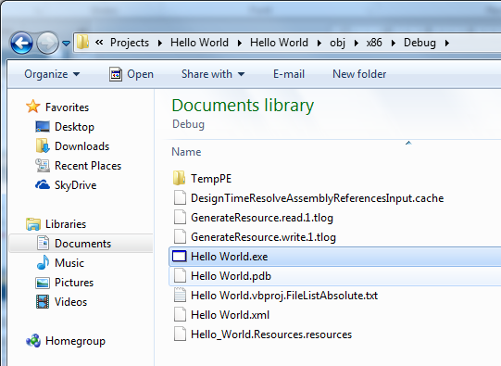
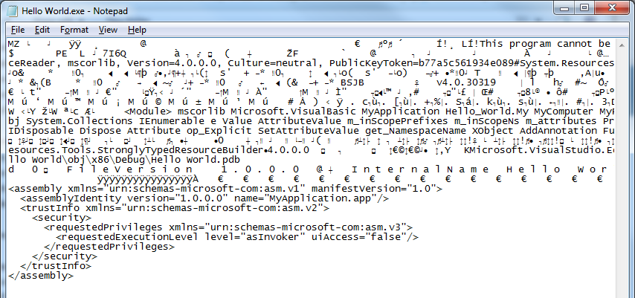
Build the Program
To build the executable (machine code file) press Ctrl + Shift + B
Other than ASCII characters, we cannot make any sense of the object code in a text editor.

Slide 6
Integrated Development Environment - IDE
More than just a compiler!
The programming environment a programmer uses to build a program is called an IDE.
The IDE is a powerful tool which supports us in coding (writing), testing, debugging and building (compiling) programs.
Visual Studio is a brilliant IDE!

Slide 7
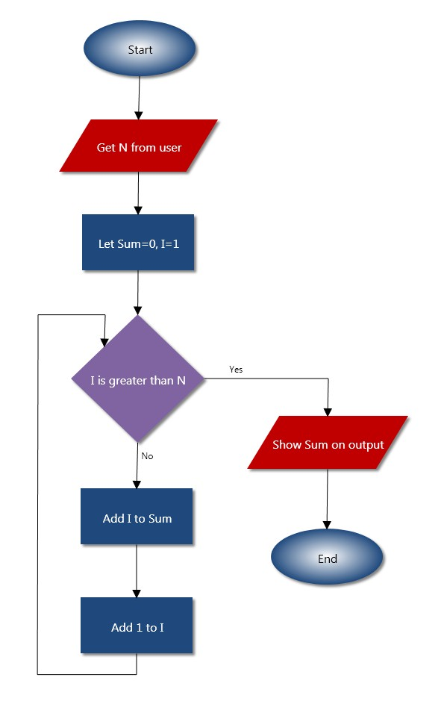
High Level Language Features
Sequence
Selection
IF..THEN..ELSE
Iteration – looping
Count controlled
Condition controlled

Slide 8
Relational Operators
Expression using comparison operators must evaluate to true or false
==
<
>
<=
>=
!=
Boolean variables – use bool type to store true/false (so we don’t need to compare the value to true/false).
int Count = 0;
if (Count == 0)
{
…
}
bool Success = true;
…
if (Success)
{
…
}

Slide 9
Program 2A – Password
Write a program to request a secret password and either grant or deny access.
const string PASSWORD = "$ecret";
string Attempt;
Console.Write("Please enter password: ");
Attempt = Console.ReadLine();
if (Attempt == PASSWORD)
{
Console.WriteLine("Access granted.");
}
else
{
Console.WriteLine("Access denied.");
}

Slide 10
Boolean Operators
AND &&
OR ||
NOT !
…
if (!Success)
{
…
}
…
if (Success == false)
{
…
}

Slide 11
Validation
What would be sensible test data for this program?
Is this code logically correct?
int i;
Console.Write("Enter a number between 1 and 10: ");
i = int.Parse(Console.ReadLine());
if (i >= 1 || i <= 10)
{
Console.WriteLine("Valid number.");
}
else
{
Console.WriteLine("Invalid number.");
}
int i;
Console.Write("Enter a number between 1 and 10: ");
i = int.Parse(Console.ReadLine());
if (i >= 1 || i <= 10)
{
Console.WriteLine("Valid number."); //tautology
}
else
{
Console.WriteLine("Invalid number."); //unreachable code
}
int i;
Console.Write("Enter a number between 1 and 10: ");
i = int.Parse(Console.ReadLine());
if (i >= 1 && i <= 10)
{
Console.WriteLine("Valid number.");
}
else
{
Console.WriteLine("Invalid number.");
}

Slide 12
Reverse Logic
e.g. Validate age range for a club 18-30 holiday.
AND – overall expression is true only if both conditions are true, e.g.
if (Age 18 && Age 30) //true if valid
OR – overall expression is true if either condition is true, e.g.
if (Age 18 || Age 30) //true if invalid
>=
<=
<
>
De Morgan’s Law:
A.B = A+B
A+B = A.B
Notes:
De Morgan’s law – first and last examples above are logically equivalent.

Slide 13
Assessment 1 – Simple Validation
Modify your solution to Assessment 1 (double glazing calculator) so that the width and height are validated as follows:
Width must be between 0.5 and 5.0
Height must be between 0.75 and 3.0
If a value is entered which is smaller than the minimum then the minimum should be used instead. Likewise for the maximum.
Some indication should be given to the user that minimum or maximum values have been used.

Slide 14
Arithmetic Operators
Order of precedence: BODMAS
Brackets
Order
Division
Multiplication
Addition
Subtraction
e.g.
4^2*2+4/2-4
Brackets help readability!
((4^2)*2)+(4/2)-4
= 30

Slide 15
Modulo Operator (MOD)
The remainder after integer division (DIV)
e.g. 18 MOD 4 = 2
4 goes into 18 (4 times) leaving remainder 2
int Remainder;
Remainder = 18 % 4;
C# MOD operator is %
int GoesInto;
GoesInto = 18 / 4;
C# does not have a DIV operator,
Because integer division truncates
(int) / (int) = (int)

Slide 16
365.2425 days
The Gregorian calendar's rule for leap years has three parts:
If divisible evenly by 4, it is a leap year, UNLESS
If divisible evenly by 100, it is not a leap year, UNLESS
If divisible evenly by 400, it is a leap year.
It takes the Earth 365 ⁹⁷/₄₀₀ days to orbit the Sun
…actually even this is approximate!
Notes:
e.g. 1996/4 = 499, so 1996 is a leap year.
e.g.1900/4 = 475, but 1900/100=19, so 1900 is a normal year of 365 days; as is 2100.
e.g. 2000/4 = 500, but 2000/100=20, but 2000/400=5, so 2000 is a leap year after all!
http://www.tondering.dk/claus/cal/gregorian.php
365⁹⁶⁹/₄₀₀₀ - drop one every 4000

Slide 17
Leap Years
The following algorithm evaluates whether or not a given year is a leap year.
IF Year MOD 4 = 0 THEN
IsLeap = TRUE
IF Year MOD 100 = 0 THEN
IsLeap = FALSE
IF Year MOD 400 = 0 THEN
IsLeap = TRUE
END IF
ENDIF
ELSE
IsLeap = False
ENDIF

Slide 18
Program 2A – Leap Years
Write a program to evaluate whether or not an input year is a leap year.
One possible solution nesting IFs
int Year;
bool IsLeap;
Console.Write("Enter year: ");
Year = int.Parse(Console.ReadLine());
if (Year % 4 == 0)
{
IsLeap = true;
if (Year % 100 == 0)
{
IsLeap = false;
if (Year % 400 == 0)
IsLeap = true;
}
}
else
IsLeap = false;
if (IsLeap)
Console.WriteLine("IS a leap year.");
else
Console.WriteLine("Is NOT a leap year.");

Slide 19
Program 2A – Leap Years
Write a program to evaluate whether or not an input year is a leap year.
Alternative solution combining conditions in a single statement
int Year;
Console.Write("Enter year: ");
Year = int.Parse(Console.ReadLine());
if ((Year % 4 == 0 && Year % 100 != 0) || Year % 400 == 0) //hard to read
Console.WriteLine("IS a leap year.");
else
Console.WriteLine("Is NOT a leap year.");

Slide 20
Arrays
Arrays occupy contiguous memory locations
Initialising an array, e.g.
Contains - Arrays can be searched using this built-in method. A Boolean value is returned by this call.
int[] PrimeNumbers = { 2, 3, 5, 7, 11, 13, 17, 19 };
if (PrimeNumbers.Contains(11))
{
…

Slide 21
Program 2B – Prime Number Checker
Write a program to request an input number (less than 20) and inform the user if it is a prime number or not.
int[] PrimeNumbers = { 2, 3, 5, 7, 11, 13, 17, 19 };
int Number;
Console.Write("Please enter a number less then twenty: ");
Number = int.Parse(Console.ReadLine());
if (PrimeNumbers.Contains(Number))
Console.WriteLine("IS prime.");
else
Console.WriteLine("Is NOT prime.");

Slide 22
String Manipulation
A single character can be read directly (because a string is really just an array of characters).
Length – A string property that gives the number of characters in the string.
string Forename = "Frank";
char Initial;
Initial = Forename[0];
Index position starts from 0
string Sentence = "The quick brown fox jumps over the lazy dog";
int NumOfChars;
NumOfChars = Sentence.Length;

Slide 23

Overloading
Different versions of any subroutine (procedure, function or method) can exist – each distinguished by the number or type of parameters.
e.g. Substring
string Name = "Aaron Aardvark";
string Forename, Surname;
Surname = Name.Substring(6);
Forename = Name.Substring(0, 5);
The method takes parameter index and optional parameter length
If length is not supplied – the assumption is made that the substring should be returned from index until the end of the string.

Slide 24
String Manipulation
IndexOf() – a method which returns the location of the first instance of a substring found within a string.
Substring – a method which returns a substring from a given starting point until the end, or a given number of characters.
string Name = "Aaron Aardvark";
string Forename, Surname;
int SpacePosition;
SpacePosition = Name.IndexOf(" ");
Index position starts from 0
Surname = Name.Substring(SpacePosition + 1);
Forename = Name.Substring(0, SpacePosition);
Substring is an overloaded method

Slide 25
Program 2C – What’s in a name
Write a program to request the user’s full name in the format “Surname,Forename” (e.g. “Aardvark,Aaron”) and then greet the user by forename and state the length of their surname (e.g. “Hello Aaron. Your surname is 8 characters long.”)
string Name;
string Forename, Surname;
int CommaPosition;
Console.Write("Please enter your name in the format Surname,Forename: ");
Name = Console.ReadLine();
CommaPosition = Name.IndexOf(",");
Surname = Name.Substring(0, CommaPosition);
Forename = Name.Substring(CommaPosition + 1);
Console.WriteLine("Hello {0}. Your surname is {1} characters long.", Forename, Surname.Length);

Slide 26
Mutually Exclusive Conditions
What is wrong with this approach?
char Choice;
Console.Write("Enter choice: ");
Choice = Console.ReadLine();
if (Choice == "A")
ProcA();
if (Choice == "B")
ProcB();
if (Choice == "C")
ProcC();
char Choice;
Console.Write("Enter choice: ");
Choice = Console.ReadLine();
if (Choice == "A")
ProcA();
else if (Choice == "B")
ProcB();
else if (Choice == "C")
ProcC();
Why carry on looking after you’ve found what you’re looking for?
The entire IF statement block can be exited when one true condition is found.

Slide 27
Program 2D
Write a program that requests a character and then outputs either the reverse case (e.g. a to A, Z to z) or a message stating that the input is not a character.
char Character;
int Code;
bool IsLetter = true;
const int ASCII_CASE_OFFSET = 32;
Console.Write("Enter character to change case: ");
Code = (int)Console.ReadLine()[0];
if (Code >= (int)'A' && Code <= (int)'Z')
Code += ASCII_CASE_OFFSET;
else if (Code >= (int)'a' && Code <= (int)('z'))
Code -= ASCII_CASE_OFFSET;
else // didn't enter a letter
IsLetter = false;
if (IsLetter)
Console.WriteLine("Opposite case is: {0}", (char)Code);
else
Console.WriteLine("You didn't enter a letter!");

Slide 28
CASE Statement
Can handle mutual exclusion
char Choice;
Console.Write("Enter choice: ");
Choice = Console.ReadLine();
switch (Choice)
{
case "A":
ProcA();
break;
case "B":
ProcB();
break;
case "C":
ProcC();
break;
}

Slide 29
CASE Statement
Can handle multiple conditions
int Number;
Console.Write("Enter Number between 1 and 10: ");
Number = int.Parse(Console.ReadLine());
switch (Number)
{
case 1:
case 2:
case 3:
case 4:
case 5:
Console.WriteLine("Between 1 and 5.");
break;
case 6:
case 7:
case 8:
Console.WriteLine("Between 6 and 8.");
break;
case 9:
case 10:
Console.WriteLine("Equal to 9 or 10.");
break;
default:
Console.WriteLine("Not between 1 and 10.");
break;
}

Slide 30
What have you learnt?
Under what circumstances are multiple IF statements necessary?
Under what circumstances would a CASE statement be more appropriate than multiple IF statements?
When would nesting be better than independent IFs?
Multiple IF statements
– many questions.
CASE
– one question with many answers (multiple-choice)
When the answer to the first question makes asking the second pointless.

Slide 31
Exercise 2 – String Calculator
Write a console program to function as a basic calculator – supporting operations * / + -
The program should allow a single digit expression to be entered without spaces, e.g.
9+3
7*4
The expression should be checked to ensure that it contains a valid operation and either evaluate and display the answer or display an error message.
The output should be given as an equation, e.g.
9+3=12
The answer should be formatted to a maximum of 3 decimal places.

Slide 32
Exercise 2 – Extension
Adapt the program to allow the user to enter an expression that contains numbers of any length (real types).
12-3
123/4
1.23*4.567
The expression should still be checked to ensure that it contains a valid operation character and then either evaluate and display the answer or display an error message.
The output should be given as an equation, e.g.
12-3=9
The answer should be formatted to a maximum of 3 decimal places.
Hint: Using the string methods Substring and IndexOf might help!

